Slide 1
Complexity: models

Slide 2
AutoML

Slide 3
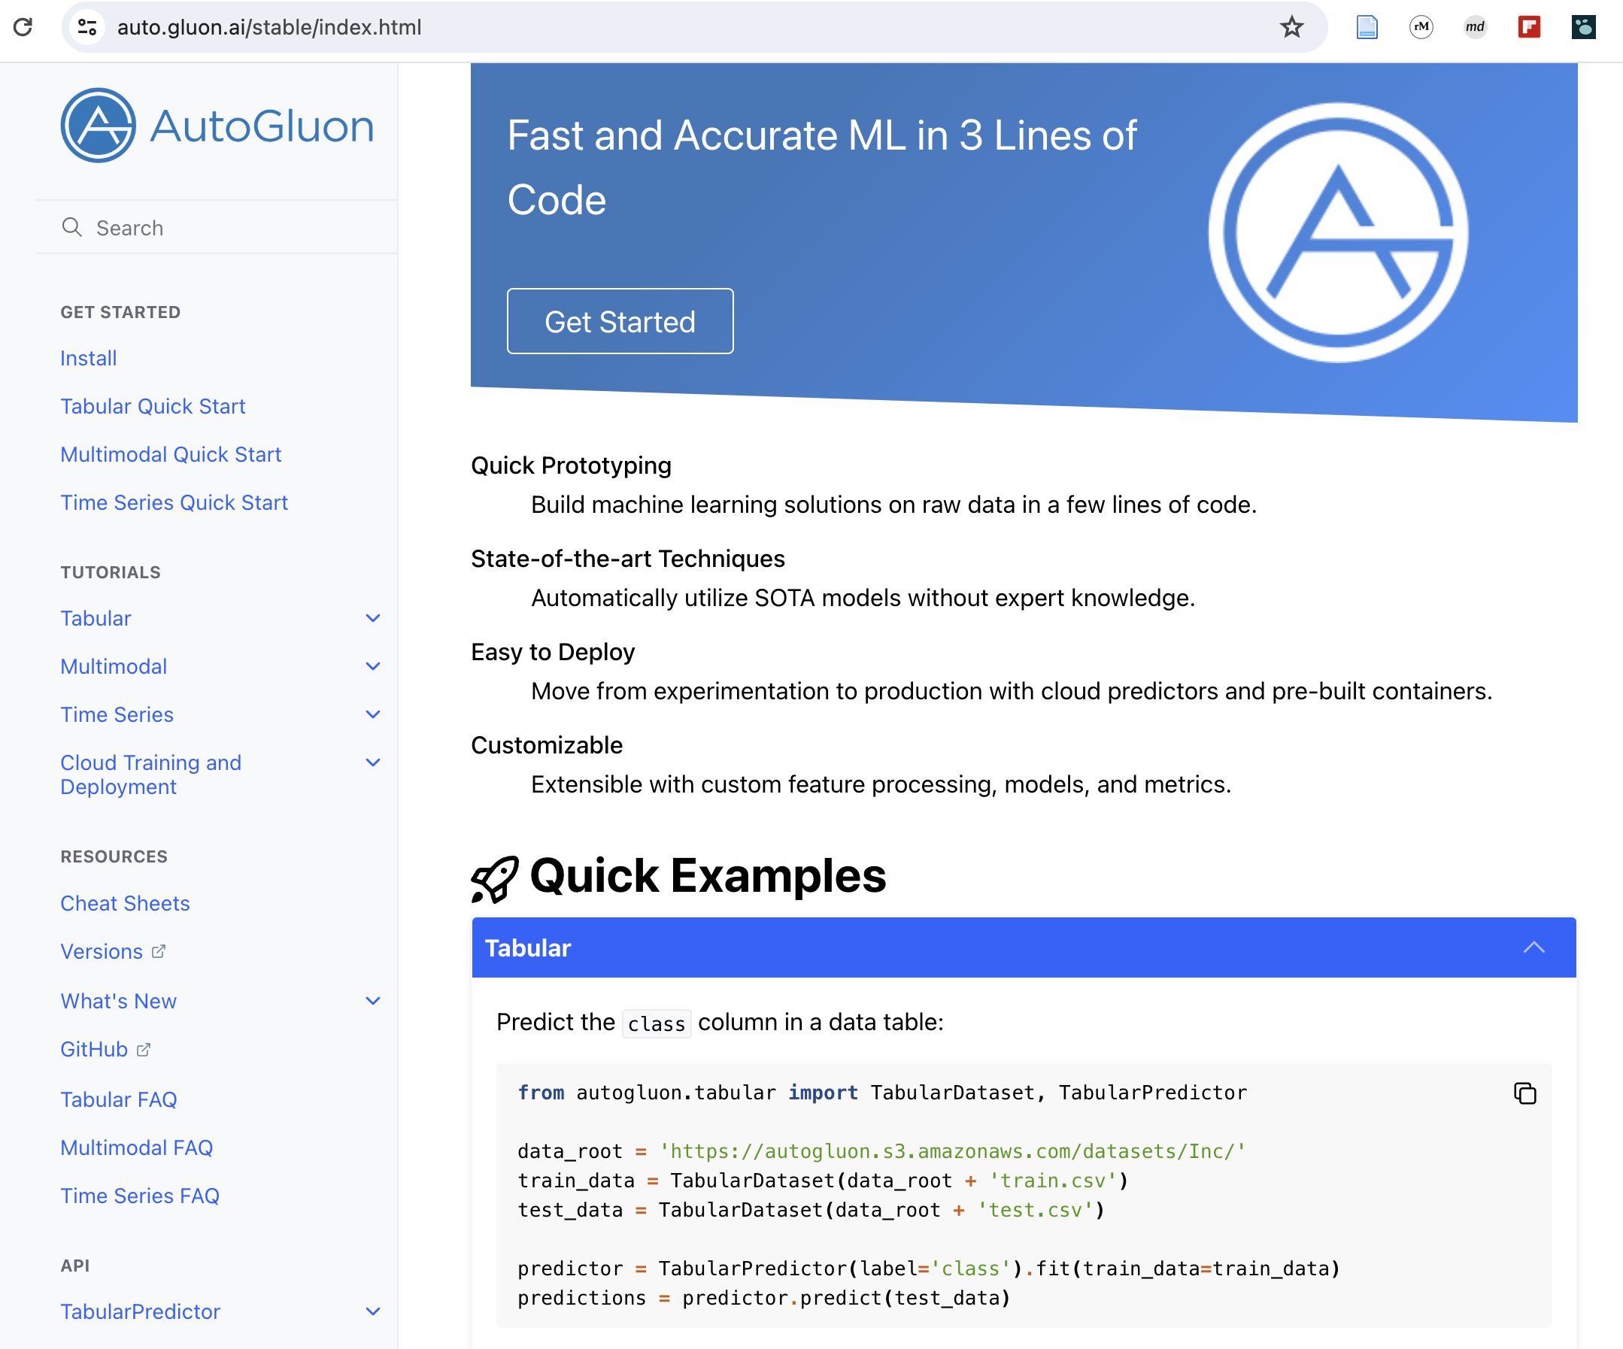

Slide 4
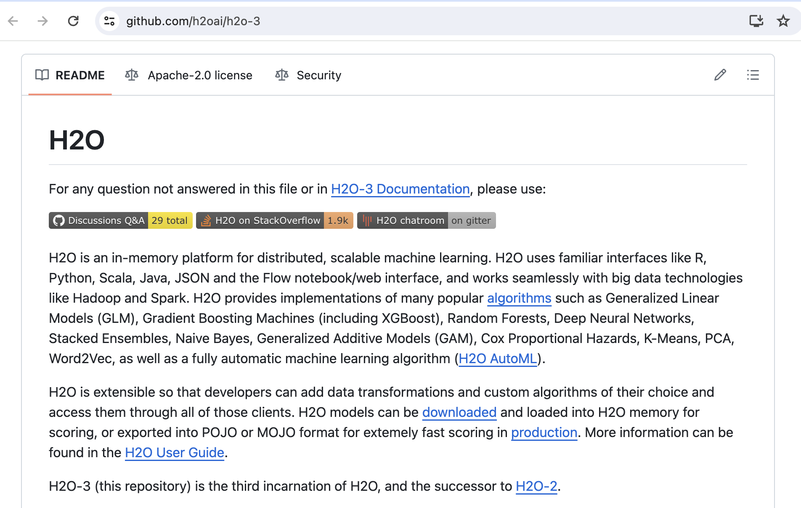

Slide 5


Slide 6
Multiple models

Slide 7
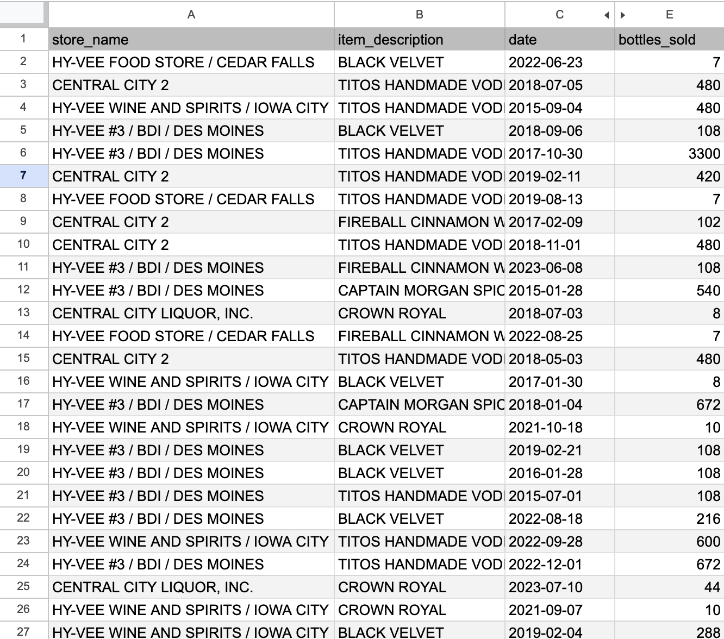

Slide 8
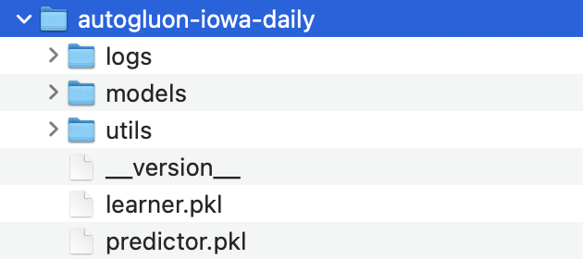
Option 1: product sales modeling
1 model
Select a product > get a forecast

Slide 9
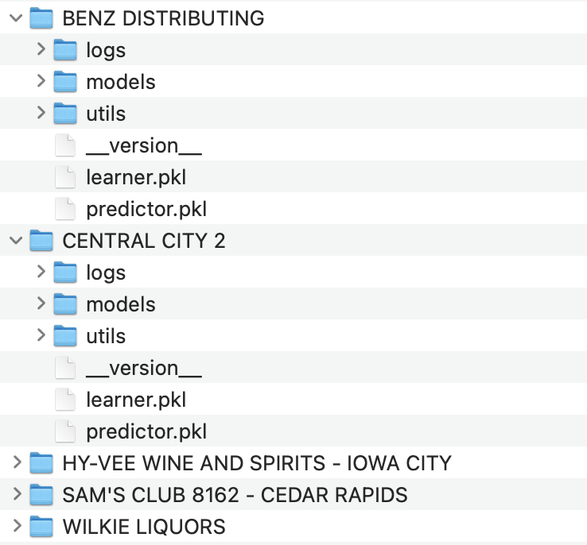
Option 2: modeling product sales in a given location
A separate model for each store
Select a store > Select a product > get a forecast
Iowa only: 3257 models

Slide 10
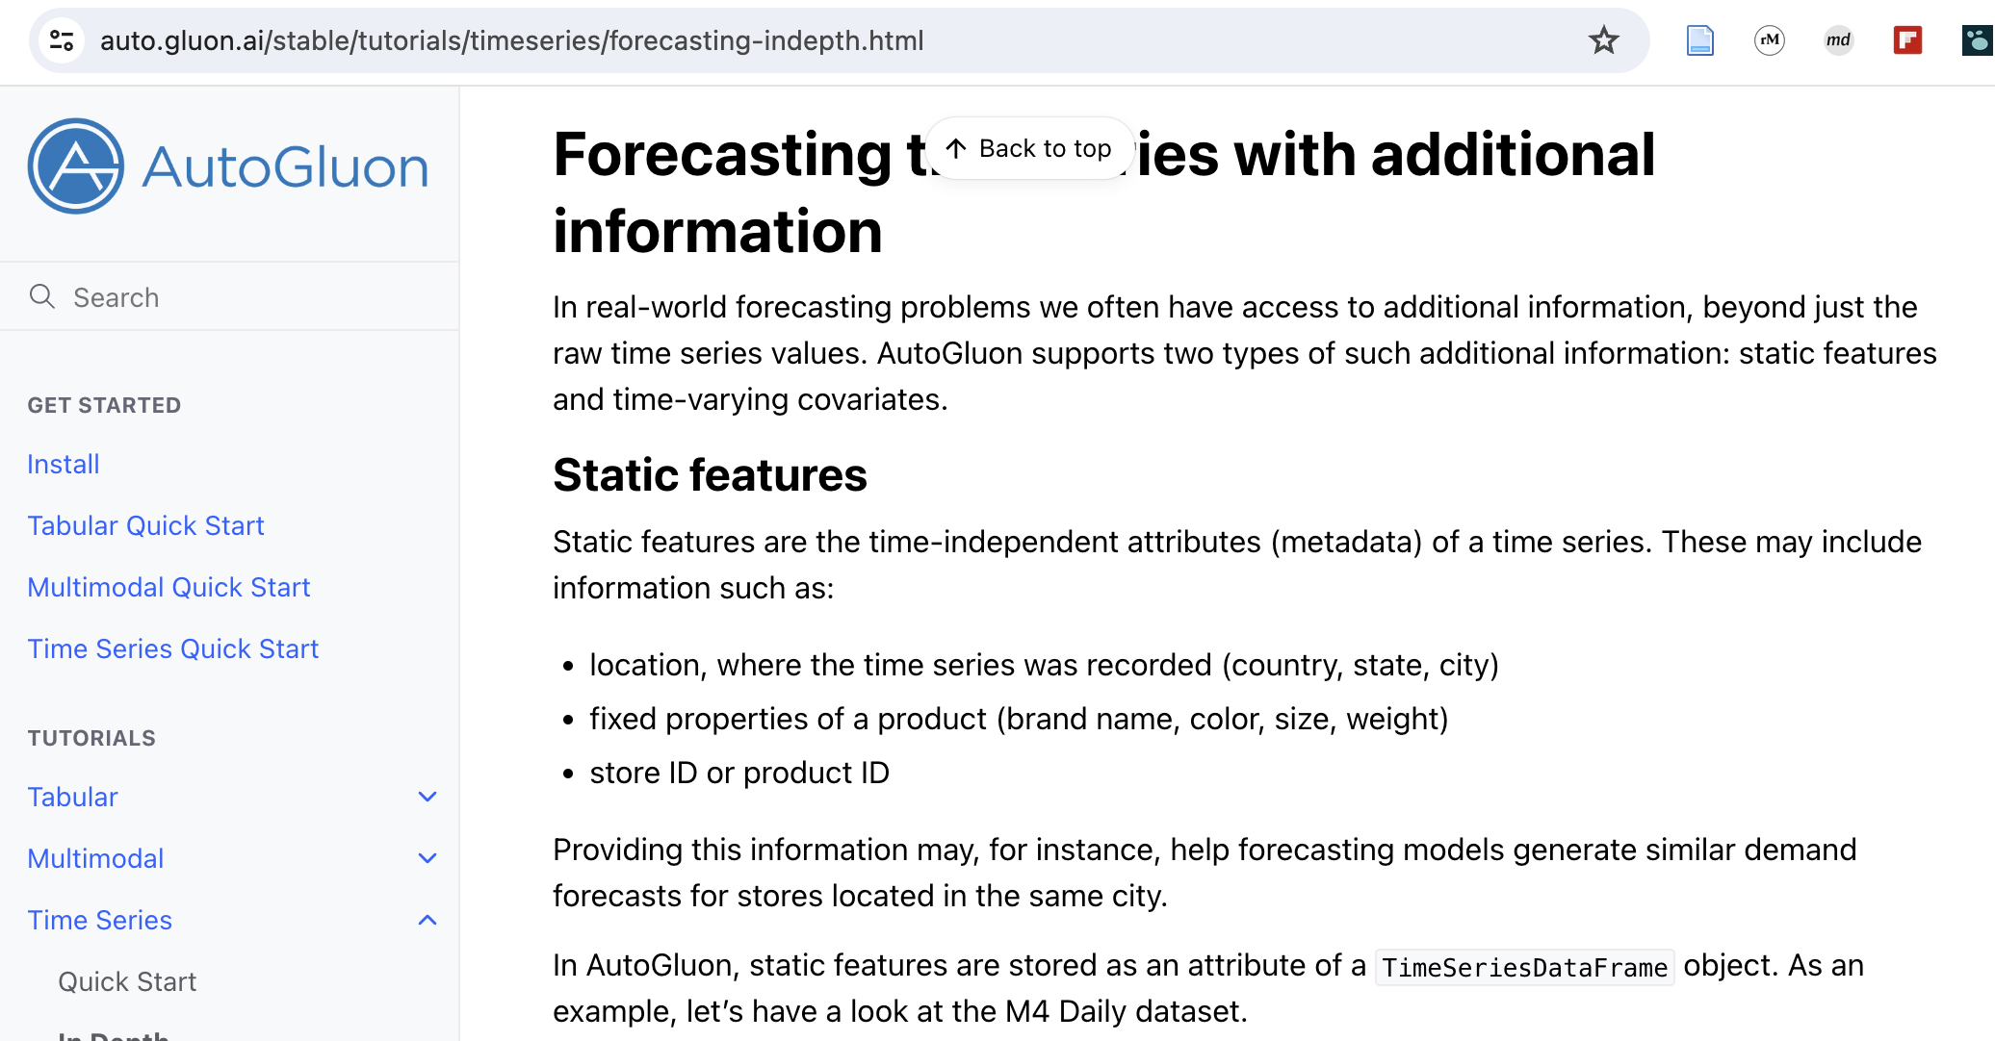
Option 3: intelligent modeling
Dynamic and static features
Panel modeling,
Etc.

